Slide 1
Introduction to CMI-14:
The fourteenth annual meeting of the Carbon Mitigation Initiative
Steve Pacala and Rob Socolow
April 14, 2015

Slide 2
CMI Structure
Research Groups:
Science
Technology
Integration
Co-Directors:
S. Pacala
R. Socolow
BP:
F. Bayon
G. Hill
Collaborators (partial list):
GFDL, Princeton NJ
Tsinghua University
Politecnico di Milano
University of Bergen
Climate Central, Princeton NJ
Advisory Council:
S. Benson, Stanford
D. Burtraw, Resources for the Future
D. Hawkins, Natural Resources Defense Council
M. Levi, Council on Foreign Relations
D. Schrag, Harvard
CMI has now been extended through 2020.

Slide 3
History
CMI began in 2000, at a time when John Browne sensed that the world might pass through a discontinuity and begin to take climate change seriously. He wanted BP to develop a comfortable relationship with a research center that would advance climate science and analyze low-carbon technology.
The following few years were indeed characterized by greatly increased interest and concern: serious initiatives in carbon trading and subsidies for low-carbon energy – including CO₂ capture and storage (CCS). Princeton and BP were leaders in this effort in our respective domains.

Slide 4
Much has changed and is changing
Low-carbon energy is arriving unevenly: wind, solar, and vehicle fuel efficiency are being realized at a one-wedge pace, while hydrogen power, CCS, and nuclear power are faltering. Low-carbon technology is being dramatically affected by the arrival of shale gas and oil.
Less recognized, in climate science new modeling capability is enabling more forceful statements about near-term effects of climate change. The international conversation, now truly global, may soon be infused with greater urgency.

Slide 5
Keeping an eye to windward
Investors in the fossil energy industries, more than any other stakeholders, want to keep an eye out to windward and to receive the earliest possible warning of transformative knowledge than could stimulate new policy formation.
CMI is committed to sustain its capacity to develop reliable information and insights about both the climate change problem and its solutions.

Slide 6
Risks of climate change for BP
The climate problem has the potential to disrupt BP’s core business in at least three ways:
Effective climate policies can emerge that discourage fossil fuel consumption, that impose environmental performance standards on production processes, and that subsidize or otherwise promote efficiency and low carbon energy.
Climate-motivated research can create disruptive new energy technology.
The consequences of climate change can directly disrupt BP’s investments in energy production infrastructure and supply chains.

Slide 7
BP supports CMI to help manage risks
1. CMI sharpens BP’s corporate perspective on climate change. It provides BP with strategic understanding of the potential physical, biological and human systems impacts.
2. BP benefits when CMI disseminates sound information that supports effective public policy discussions.
3. BP leverages the much larger research programs of the CMI investigators.

Slide 8
Agenda and goals
Agenda item | Why included?
TODAY
This talk | Introduce/reintroduce CMI
Five research talks | Updates on the CMI program
Smith and Greig | CCS vision: roles for government and industry
Deep dive #1: CH₄ and CO₂ leakage | Risk analyses: new results
Ellen Williams | Fostering innovation at ARPA-E
TOMORROW
BP Review | Report on BP evolution and reengagement
Advisory committee | Independent perspectives on CMI
Deep dive #2: When will global emissions peak? | Global economic modeling, views from China, U.S.

Slide 9
IPCC Fifth Assessment Report: Now history
The IPCC’s Fifth Assessment Report is now complete: four reports. Relation to this meeting and CMI:
Ottmar Edenhofer
  Working Group III Report, “Mitigation of Climate Change”
    Co-chair. Talk tomorrow morning
Michael Oppenheimer
  Working Group II Report, “Impacts, Adaptation, and Vulnerabilities”
    Convening Lead Author, Chapter 19: ”Emergent risks and key vulnerabilities”
    Member, writing team, Summary for Policy Makers
  Synthesis Report
    Member, core writing team
GFDL: How much can the Sixth Assessment Report deviate – especially the Working Group I Report, “The Physical Science Basis”?

Slide 10
“Best-Paper Prize,” 2014
Zhong Zheng, Bo Guo, Ivan C. Christov, Michael A. Celia, and Howard A. Stone, “Flow Regimes for Fluid Injection into a Confined Porous Medium,” Journal of Fluid Mechanics 767: 881-909.
The paper characterizes the rates at which two fluid phases (e.g. supercritical CO₂ and water) rearrange in a porous medium, taking into account the physical properties of the injected fluid, the displaced fluid, and the porous medium, as well as the injection rate. The analysis provides simplified representations of the output of the large numerical models commonly used in industrial simulations.
The research is inspired by CO₂ sequestration. It should be helpful for the planning and interpreting of field experiments and for the development of policies and regulations.
Zheng has prepared a poster for this meeting.

Slide 11
Posters
Science Group:
Xinning Zhang: “Nitrogenase activity in the environment and nitrogen cycling”
Johanna Goldman: "Biological CO₂ fixation in polar oceans”
Paul Gauthier: “Shedding light on leaf respiration of arctic birch trees”
Carolina Dufour: “The uptake of anthropogenic CO₂ by the Southern Ocean”
Ivy Frenger: "Processes affecting anthropogenic carbon in the Southern Ocean."
Alison Gray: "Observations of the carbon cycle in the Southern Ocean from autonomous profiling floats"
Technology Group:
Bob Williams: “The strategic importance of a BioNG/CCS-Marcellus market”
Ryan Edwards: “CO₂ injectivity and storage for sequestration in shale gas wells”
Anna Hailey: “Clean fuels at small scale from biomass and natural gas”
Amir Haji Akbari: “Computational studies of ice nucleation in the atmosphere”
Zhong Zheng: “Reduced-order models for energy and environmental problems”
Yao Lai: “Fluid-driven fracture of the elastic matrix followed by backflow”
Minnie Liu: “Mechanical probes of states of health and charge in Li-ion batteries”
Integration and Outreach Group:
Phillip Hannam: “Competing energy regimes: China and India’s coal power sector”

Slide 12
Capturing the meeting
On the CMI website, http://cmi.princeton.edu/:
  Slides of all (or nearly all) presentations, perhaps some of the talks accessible only with a password.
  Notes from each session, summarizing the papers and discussion, prepared by grad students (two to a session). No attribution without specific permission.
Group photo just before lunch today.

Slide 13
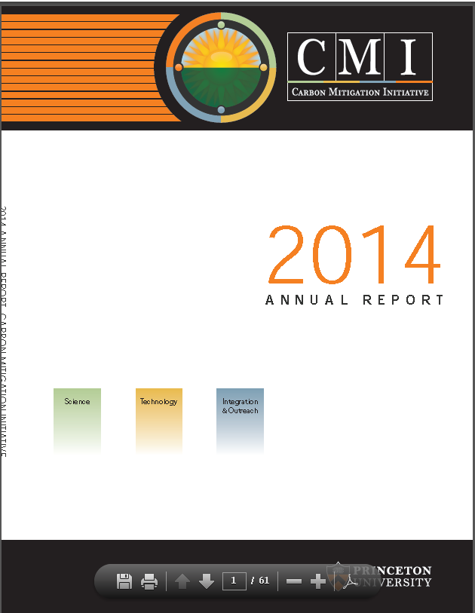
Our Annual Report
Relative to previous annual reports:
Changed: A single “highlight” (rarely, two) from each investigator.
Retained: A comprehensive record of publications.

Slide 14
Research Update this morning (5 talks)
Steve Pacala, “CMI Science: The Land Sink, Extreme Events”
Jorge Sarmiento, “Southern Ocean”
Discussion
BREAK (10:30-11:00 a.m.)
François Morel, “Ocean Acidification
Thomas Delworth,, GFDL & Princeton, “A Link Between the Hiatus in Global Warming and North American Drought”
Robert Socolow, “Low-Carbon Technology; Carbon Budgets and Committed Emissions”
Discussion

