Slide 1
1) Low-Carbon Technology 2) Carbon Budgets and Committed Emissions Robert Socolow April 14, 2015

Slide 2
CMI Technology 2015
Celia* CO₂ injection into depleted shale-gas wells
Stone† Flows in porous media
Arnold† Battery performance
Panagiatopoulos,
Debenedetti , Tromp† Molecular modeling of CO₂ capture and storage
Larson, Williams, Kreutz† Negative-emission biofuels
* Talk this afternoon
† Poster

Slide 3
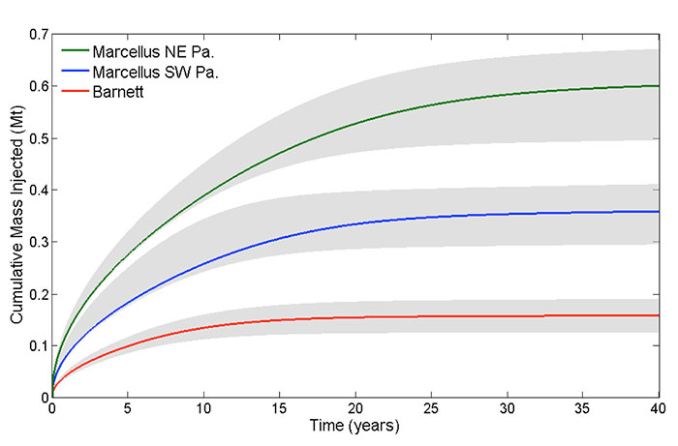
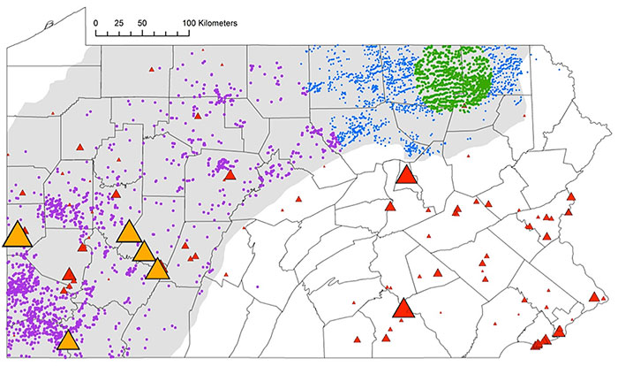
CCS via shale-gas injection (Celia)
6400 wells
3800 wells
0.5
20
40
Time (years)
Cumulative injection (MtCO₂), typical well.
Note: half the capacity is reached in ≈5 years.
Thousands of wells are required to store the 40-year output of 5 large coal power plants (orange triangles. Gray region: Marcellus shale formation.

Slide 4
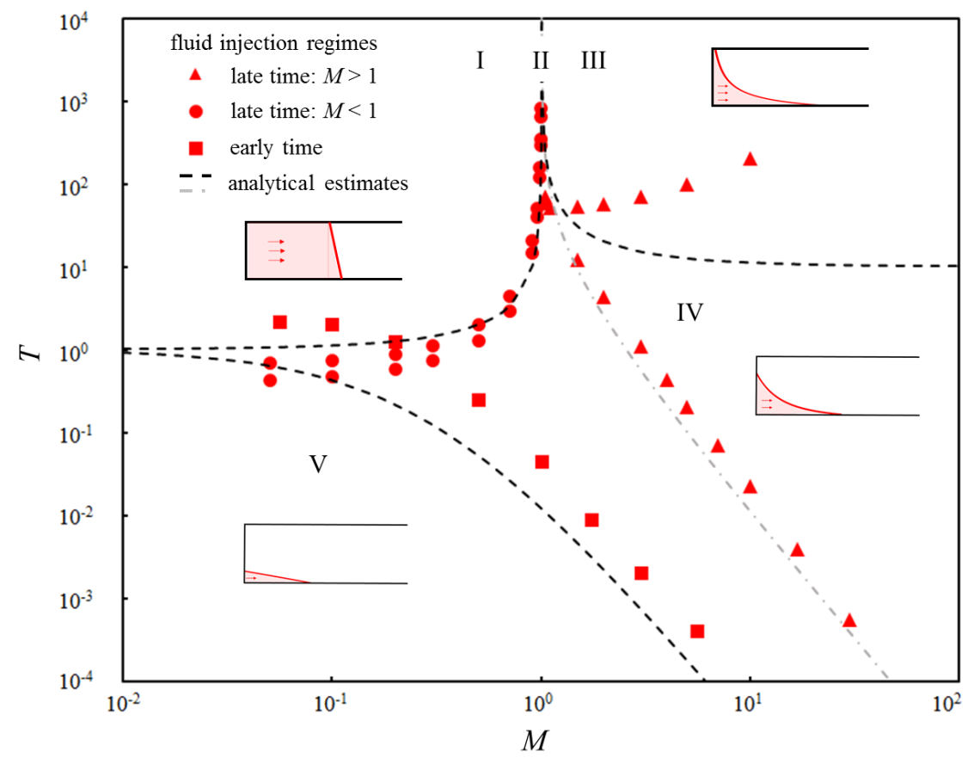
Flow regimes for fluid flow into a confined porous medium (Stone)
Late
Injected fluid is more viscous
Displaced fluid is more viscous
Early
Five distinct dynamical regimes are identified, depending on two dimensionless groups: M, the viscosity ratio of the displaced fluid to the injected fluid, and T, the dimensionless time. The regime boundaries are indicated by symbols (numerical estimates) and dashed curves (analytical estimates). Typical shapes of the fluid-fluid interface are also shown in each individual regimes.

Slide 5
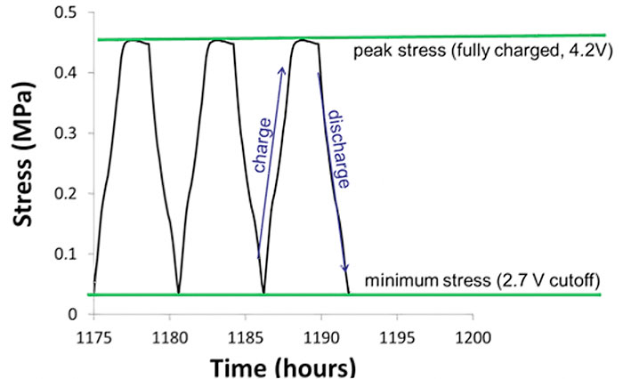
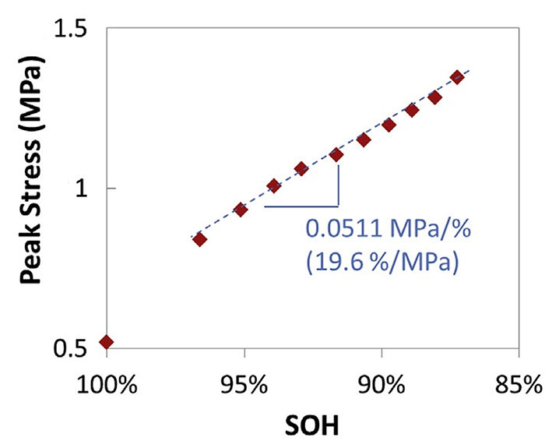
Battery states of charge and health: novel measurements (Arnold)
During charging, Li+ enters the negative electrode and its stress increases.
Peak stress increases
as a battery ages.

Slide 6
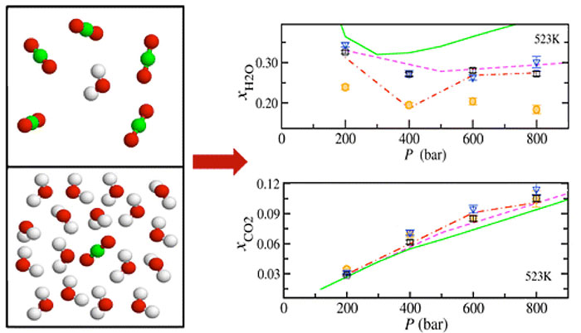
Molecular modeling of CCS Panagiatopoulos, Debenedetti , Tromp
“8 km”
Two-phase CO₂-H₂O system
Composition modeled (points)
and measured (lines)
Note: Poster is on ice nucleation and clouds.

Slide 7
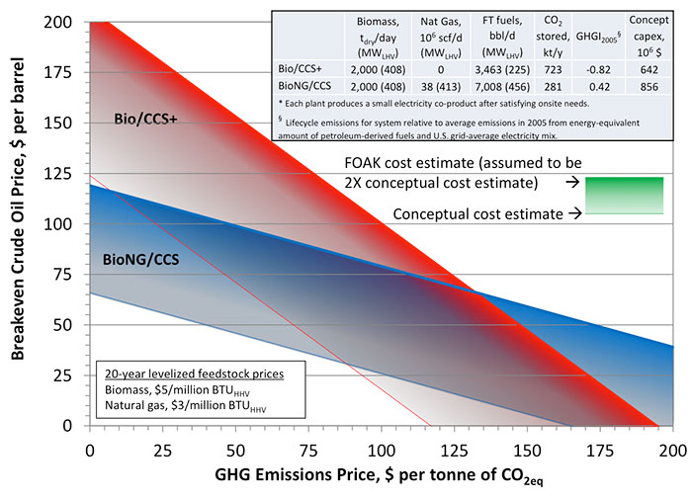
Negative-carbon biofuels Larson, Williams, Kreutz
Input: 2000 dry tons/day biomass @ $5/MMBtu.
Output:
3500 bbl/d synfuel
720 ktCO₂/yr
Modular (7 synfuel units).
Biocarbon disposition:
59% underground
37% in synfuels
4% vented.
Breakeven CO₂ and oil prices for biomass to liquids (with and without natural gas boost), modular synthesis units, CCS, shale injection

Slide 8
CMI Integration 2015
Climate Variability Project* Hiatus, urban heat, climate extremes
Oppenheimer* Estimates of future sea level rise
Glaser Re-engineering the nuclear future
Socolow Commitment accounting, carbon budgets
*discussed earlier by Pacala

Slide 9
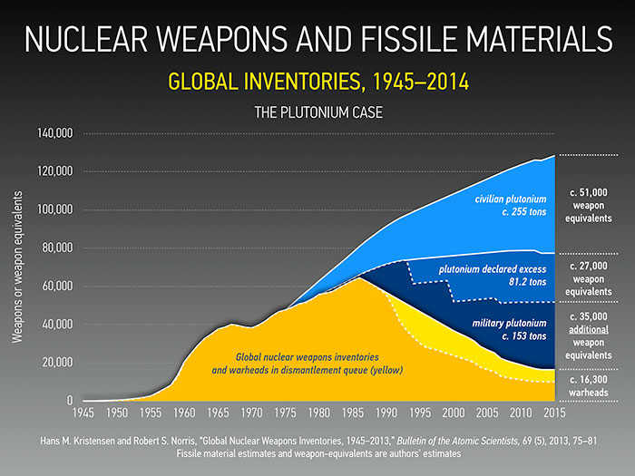
Risks of small modular reactors (SMRs) (Glaser and Ramana)
SMRs (<300 MW capacity) may provide lower costs per kW than large plants (>1000 MW), if modularity can be exploited. Positive, from the perspective of climate change (low-carbon). Risky, from the perspective of encouraging weapons programs.
Many SMR concepts are in play, some more fraught than others. Current emphasis is on smaller versions of today’s reactors: the devil we know.
255 tons of Pu have been separated from the world’s civilian spent nuclear fuel at reprocessing plants, making accessible nearly as much Pu as has been produced in the world’s military programs. Some SMRs simplify access to Pu, relative to today’s large plants.

Slide 10
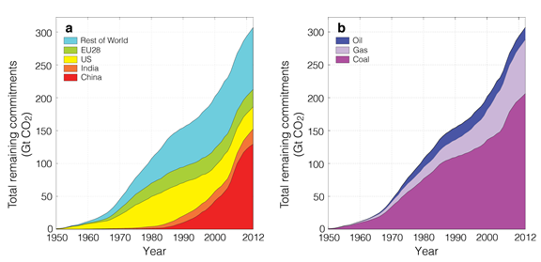
Commitment accounting: beyond power plants
300 GtCO₂
Figure 3.5.1. Remaining emissions for the world’s power plants, as of each year from 1950 through 2012. Panels (a) and (b) disaggregate by regions of the world and by fuel. From Davis and Socolow, 2014.
The full data set shows the dominance of coal, fueling the industrialization of Asia. (Hannam poster)
1950
2012
Work plan: Understand committed emissions associated with upstream fossil fuel investments.

Slide 11
Carbon-budget targets
The world’s fourth try at framing a global climate target:
Emission rate at some future date
Concentration never to be exceeded
Surface temperature never to be exceeded
Budgets (“cumulative emissions from now on”): IPCC, 2013
Notes:
CCS expands the budget.
Aerosols are assumed to have become unimportant.
Ambiguities: Is land-use change included? Are methane and other greenhouse gases included (CO₂ vs. CO_{2eq})?

Slide 12
Budget estimates
O GtCO₂ 1700 3000 4500
Already
2ºC
3ºC
So far: 1700 billion tons of CO₂ have been emitted
2ºC budget 1300 billion tons of CO₂ still could be emitted)
3ºC budget another 1500 billion tons of CO₂
The 1300 and 2800 GtCO₂ budgets correspond to 50% probability of meeting the target.
Later, we will simplify the bar above by assuming that 1600 GtCO₂ is the size of each of its three segments.
Source for Budgets: 2014 IPCC AR5 Synthesis Report, p. 68: Table 2.2: “Cumulative CO₂ emission consistent with limiting warming to less than stated temperature limits at different levels of probability, based on different lines of evidence. {WG1 12.5.4; WGIII, 6}”

Slide 13
Buried hydrocarbons: enormous resources
Fossil fuels are so abundant that, for any cumulative-emissions target, even a weak one, attractive fossil fuel will be left in the ground.
** ** **
Huge “resources” of fossil fuels. McKelvey diagrams (cost vs. level of certainty) connect “resources” and “reserves.”
Resources become reserves over decades (not years and not centuries).
Booked reserves are small, in this conversation. They are not the issue. Boardroom decisions about investing in new regions like the arctic and in new countries like Oman – are!

Slide 14
Resource estimates
O GtCO₂ 1700 3000 4500
Already
2ºC
3ºC
1000 billion tons of CO₂ (1000 GtCO₂) result from burning:
2 trillion barrels of oil
20,000 trillion cubic feet of gas [factor of 1000 error in Annual Report!]
300 billion tons of coal.
Resources in the ground, according to Rogner, in units of GtCO₂:
Oil 8,000
Gas excluding clathrates 3,000
Clathrates 40,000
Coal 20,000
Total 70,000
Point of reference: 1 “stabilization wedge” is 100 GtCO₂ not emitted.
Source: Rogner, H-H, 1997. “An assessment of world hydrocarbon resources,” Ann. Rev. Energy and Env. 22, pp. 217-262. The table reworked here is on p. 249. Estimates include “additional” resources.

Slide 15
Vann’s View of World Oil Supply
1 TB = 1*10¹² barrels.
Rectangles:
30 billion barrels/yr* 33 yrs
30
2105
1TB
1TB
1TB
1TB
1TB
“Hubbert’s peak” is a world with only 1 TB of new oil: the two dark triangles are back-to-back.
The “high case” (3 rectangles, 5 TB), has its peak today but also has a century-long plateau.
Carbon equivalent:
4 TB ≈ 2000 GtCO₂ ≈ 1ºC to 1.5ºC
Sources of New Oil | Low Case (TB) | High Case (TB)
Production | 1.0 | 1.0
Reserves | 1.0 | 1.0
Exploration | 0.25 | 0.75
Reserves Growth | 0.5 | 1.0
Non-conventional | 0.25 | 1.25
Total | 3.0 | 5.0
Source: Ian Vann, talk at London Geological Society, October 12, 2005

Slide 16
Analogous carbon emission trajectories
“Hubbert peak”
equivalent
Rectangles:
40 billion tCO₂/yr* 40 yrs
40
≈2ºC
40
≈3ºC
1600
1600
1600
1600
1600
1940
2020
2100
1940
2020
2060
2140
16 rectangles
28,800 GtCO₂
40% of Rogner resources
40
≈8ºC
2020
2740

Slide 17
Gas v. coal: two 1600 GtCO₂ rectangles
40 GtCO₂/yr –
}
40 GtCO₂/yr –
}
OIL
OIL
32 Bbbl/yr
32 Bbbl/yr
OIL
OIL
}
GAS
160 Tcf/yr
GAS
}
320 Tcf/yr
COAL
GAS
4.8 Bt/yr
COAL
COAL
2.4 Bt/yr
40 years
40 years
G = B = 10⁹, T = 10¹²
Additional primary energy: ≈3000 EJ

Slide 18
$100/tCO₂
Carbon prices for 2ºC targets in the IPCC WGIII integrated assessment models typically exceed $1000/tCO₂ before 2100!
How would various industries respond to an economy-wide carbon price of $100/tCO₂?
Upstream, the impacts are particularly dramatic upstream. $100/tCO₂ is:
$40/barrel of oil
$5/million Btu of natural gas
$200/ton of high-quality coal.
Downstream, if price-independent distribution costs are added, retail price increases are smaller, in percent. $100/tCO₂ is:
$0.80/U.S. gallon of gasoline
$0.08/kWh electricity from coal
$0.04/kWh electricity from natural gas.

Slide 19
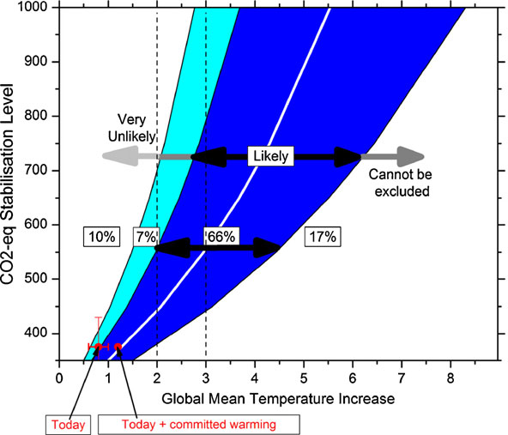
Caveat: Geophysical uncertainties
CO₂ concentration determines warming, so far, only weakly
450 ppm: 50% chance of 2ºC warming, but 17% chance of 3ºC.
550 ppm: 50% chance of 3ºC warming, but still 17% chance of only 2ºC.
Calm
world
Concentration
Twitchy
world
Warming
Warming (ºC) | Central value (ppm) | Two-thirds probability range (ppm)
2 | 450 | 380-550
3 | 550 | 450-780

Slide 20
A soft landing for 2ºC?
Failing to follow a 2ºC path could be disempowering. But giving up will get the world to 4ºC-5ºC, or more.
A soft landing for 2ºC might take the form of an international consensus that 3ºC warming is both reckless and avoidable.
Beating 3ºC vs. beating 2ºC is the difference between putting on the brakes and slamming on the brakes, assuming the central concentration estimates hold (550 and 450 ppm).
Beating 3ºC is consistent with smart global economic development, careful scrutiny of nuclear power, protection of the wild biosphere, going very slow with geoengineering.
Note: Too early to give up on 500 ppm (≈2.5ºC central estimate).

Slide 21
“Emissions budgets” mean choices
The budget concept leads inexorably to choices:
When? Better options someday?
Whose? Geopolitical stability
Used where? “Fairness”
For what purpose? Who judges?
Which fossil fuels? Those with the highest H/C ratio?
Such decision-making is unprecedented.

Slide 22
Some integration products from CMI
“Stabilization wedges” (Pacala and Socolow, Science)
“One billion high emitters” (Chakravarty et al., PNAS)
A sustainability-based classification of biomass feedstocks (Tilman, Socolow, et al., Science)
The fateful choice between nuclear power and climate change (Socolow and Glaser, Daedalus)
CO₂ capture from air (Socolow, Desmond, et al., American Physical Society)
Ocean iron fertilization to remove atmospheric CO₂ (Sarmiento group)
Sea-level rise: science and risk communication (Oppenheimer)
Monitoring of compliance with international agreements (Pacala, NRC)
Committed emissions (Davis and Socolow, Environmental Research Letters)

